Slide 1
Healthcare Analytics
Axon Healthcare

Slide 2
Project Overview
Developed a BI dashboard for Electronic Medical Records (EMR) to provide real-time, actionable insights to healthcare providers and administrators.
Aimed at improving patient care, optimizing hospital operations, and supporting evidence-based decision-making.
Focused on KPI-driven analytics for patient demographics, chronic conditions, treatment costs, and geographic distribution.

Slide 3
Objectives
Monitor KPIs such as patient volume, follow-up rates, doctor workload, and treatment costs in real time.
Identify patterns in chronic diseases and allergies to improve preventive care and resource allocation.
Analyze patient demographics for targeted healthcare programs.
Evaluate geographic distribution of patients to improve outreach and service accessibility.
Support cost optimization by tracking average treatment costs and identifying high-cost areas.
Enable proactive interventions by forecasting trends in patient visits and conditions.

Slide 4
Methodology
Data Integration – Extracted patient, visit, treatment, and lab result data from EMR systems.
Data Cleaning & Transformation – Removed inconsistencies, standardized formats, and ensured compliance with healthcare data privacy regulations.
Database Structuring – Stored data in a secure, relational database with optimized queries for fast analytics.
Dashboard Development – Built interactive visualizations in Tableau and Power BI with drill-downs, filters, and trend analysis.
Quality Assurance – Validated insights with medical staff and ensured alignment with hospital KPIs.

Slide 5
Tools & Technologies Used
Excel
SQL
Tableau
Power BI
PPT
Data Visualization & Analytics

Slide 6
Key Achievements / Outcomes
Improved operational efficiency by enabling real-time monitoring of patient flow and doctor workloads.
Identified top chronic conditions, allowing better allocation of medical resources.
Revealed cost patterns that helped reduce unnecessary expenses in patient treatments.
Enhanced preventive care strategies by analyzing allergy and chronic condition trends.
Increased patient engagement through insights on follow-up visit patterns.

Slide 7
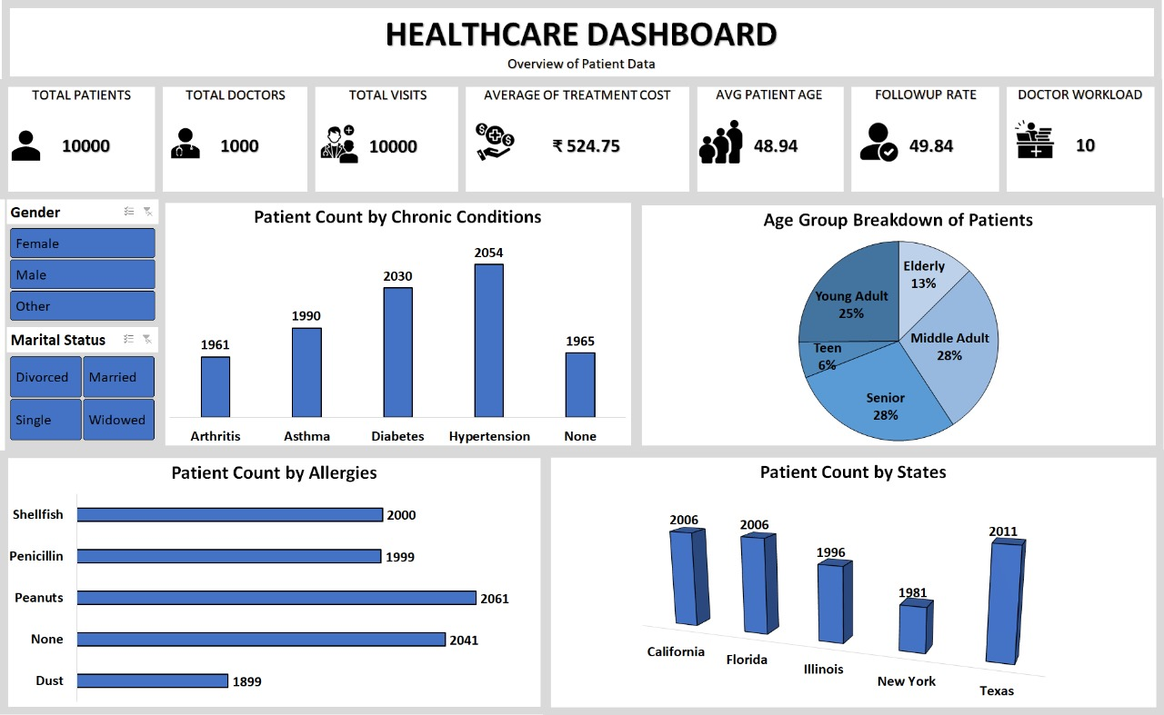
Excel Dashboard – Placeholder
Insert Dashboard Screenshot Here

Slide 8
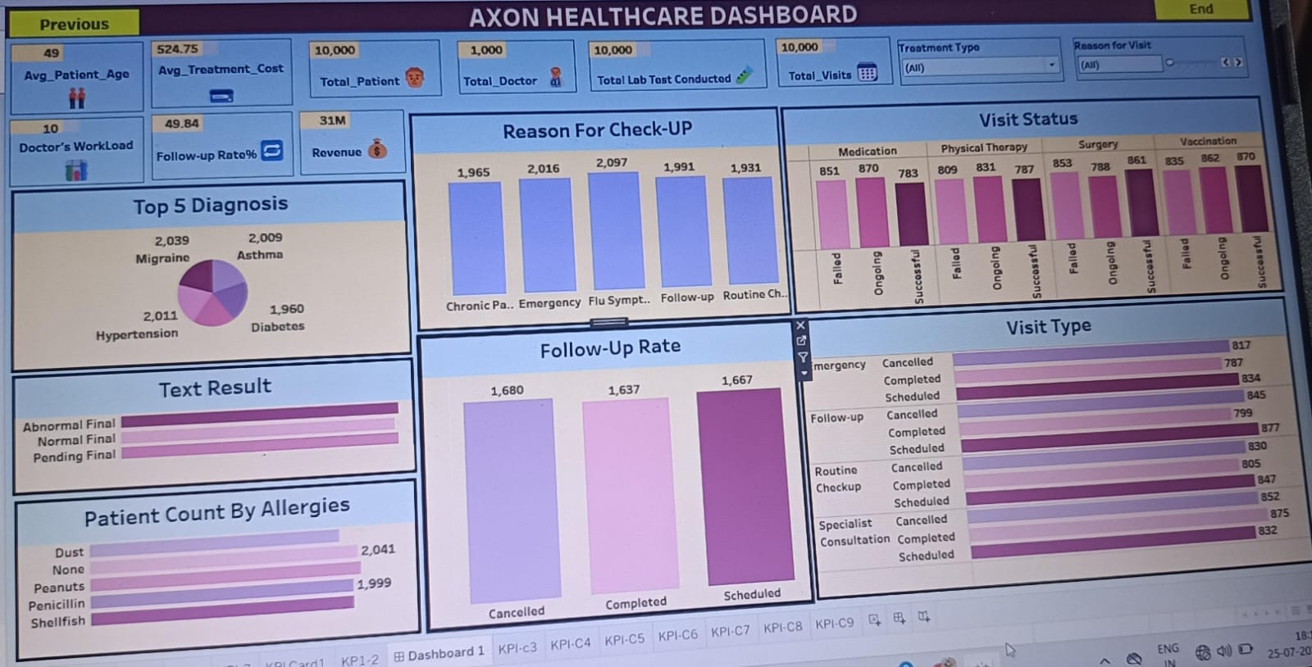
Tableau Dashboard – Placeholder
Insert Dashboard Screenshot Here

Slide 9
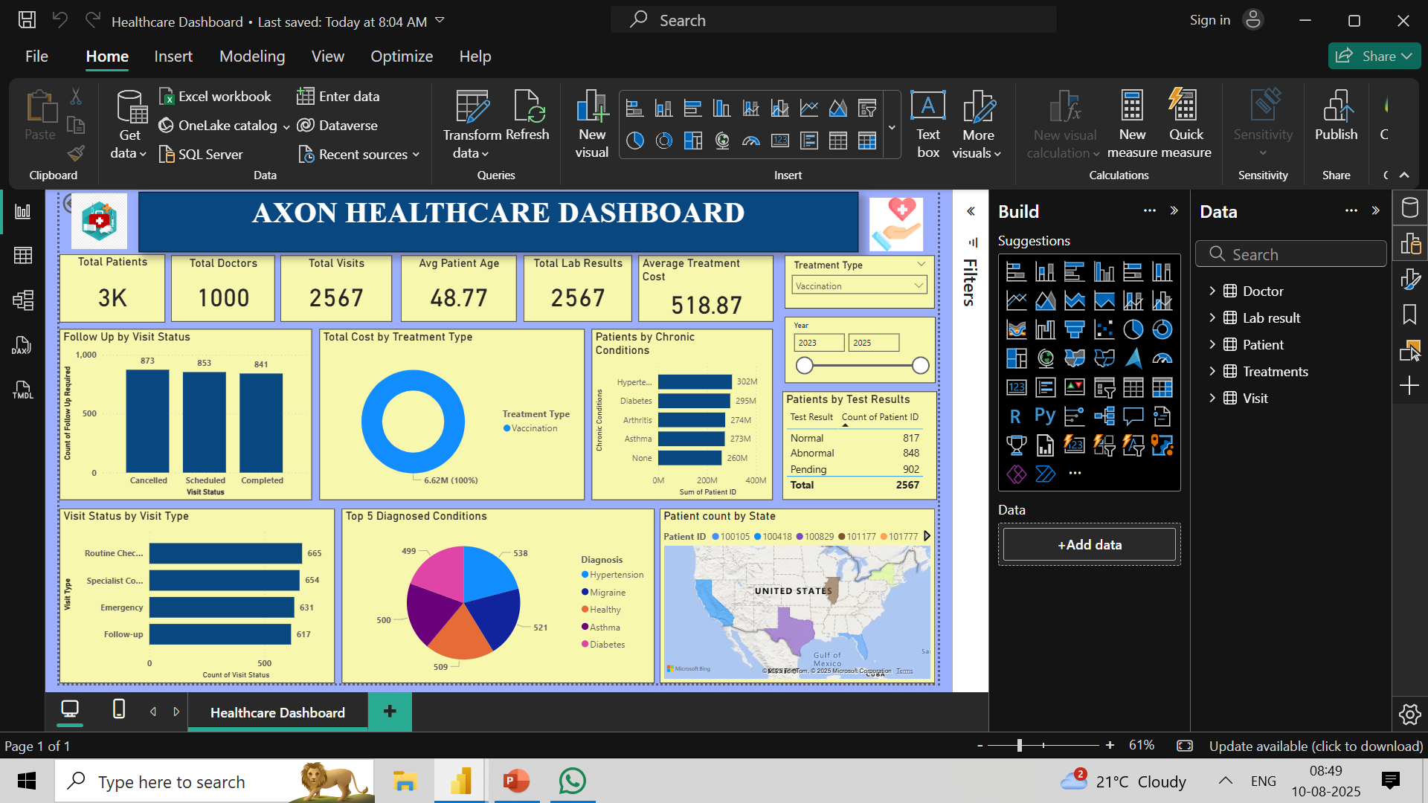
Power BI Dashboard – Placeholder
Insert Dashboard Screenshot Here

Slide 10
Learnings & Skills Gained
Hands-on experience in BI tools and SQL
Improved data cleaning and transformation skills
Enhanced ability to work in a collaborative project environment
Stronger understanding of healthcare analytics KPIs

Slide 11
Conclusion & Future Scope
Project successfully met objectives and delivered actionable insights
Future improvements: automation of data refresh, advanced predictive modeling
Potential to integrate with real-time healthcare data sources

